Slide 1
JWT Role Based Authentication
in
Spring boot

Slide 2
Day 1

Slide 3
Generally, there are two types of authentication techniques.
Stateful Authentication
Stateless Authentication
Both happen in a client & server concept in such a way that Server provides a service to a Client only after authentication.
Here clients can be a browser or another server again.

Slide 4
Stateful Authentication
There is a session management involved between client & server.
When a client requests for a service from a server.
Then server creates a session and stores user information in the form of key – value pairs.
This session is a kind of memory at server side.
User
Server
Request

Slide 5
We can also call it HttpSession as Http protocol manages it.
The server provides a session id with the response in the form of Cookie to the client.
That cookie gets stored in the client browser.
Server
User
Response
Session Id

Slide 6
When the same client makes request for the second time, cookie also comes with the request header.
Consequently, the server checks the request header and if it finds the same SID (Session id) in the cookie it assumes that the request came from the same client.
In this way the session management works.

Slide 7
When a client logs out from the server, the session gets destroyed accordingly.
As a result, the server removes the session information (key-value) from the memory accordingly.
For every new client, the server creates a new session(memory).

Slide 8
Stateless Authentication
When a client sends a request to the server for a service
Server
User
Request
Token
The server generates a token in the form of encoded format and sends to the client with the response.
While making second request, Client sends the same token along with the request to the server

Slide 9
Now, the server reads token from the request and validates the token.
In fact, from the first request server checks the valid login(credentials) of the client.
If it is a valid login, then only, server creates a token and send to the client.
Furthermore, on the second request it validates the token.
If the token is valid the server sends the requested response, otherwise asks to the client to login again.

Slide 10
However, every token will have a valid time period, such as 30 minutes, 1 hour etc.
Based on business requirements, token validity period we will be configured.
In case of Token, there is no concept of logout. Instead, the client can make a request & get the response until the token expires.

Slide 11
Day 2

Slide 12
What is a Token ?
Token is a data in the form of encoded format.
It can be generated by using a secret key(a kind of password).

Slide 13
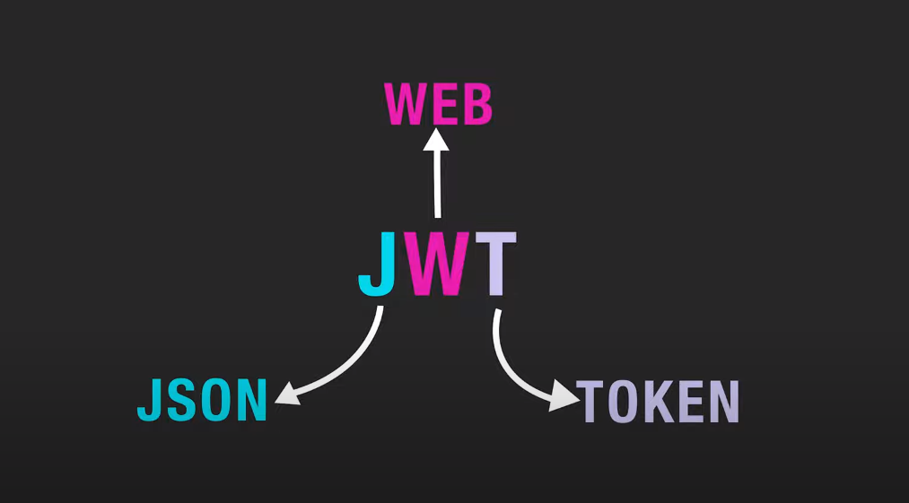
JWT JSON Web Token, which is a standard mechanism to generate tokens.
It defines a compact and self-contained way of transmitting information securely between parties(multiple servers) as a JSON object.
It's an open-source API.
JWT concept exists not only in Java, but also in other languages.

Slide 14
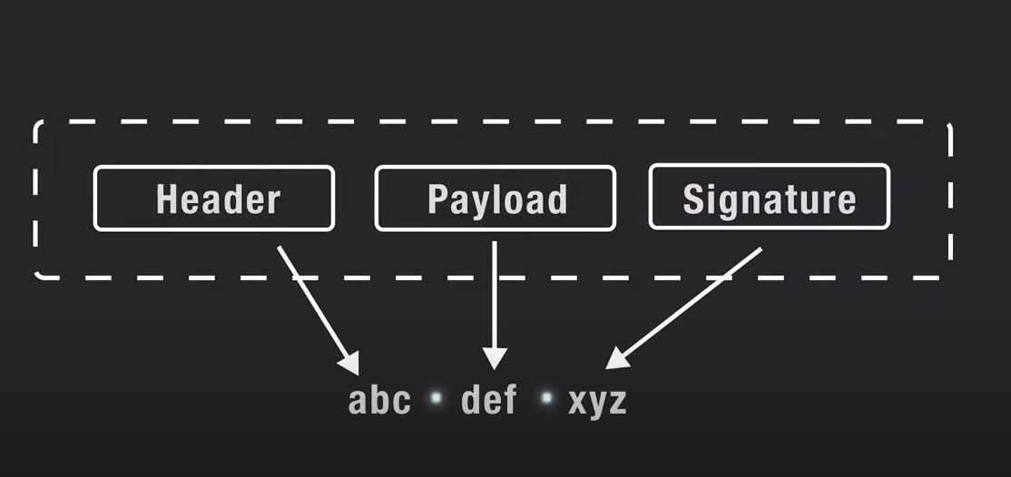
JWT has three parts : Header, Payload & Signature.
Each part is separated by comma.

Slide 15
Header : contains JWT Specific Information
Payload : contains Claims (Client ID, Client Name, Issuer Name, Audience Name, Date of issue, Expiry date etc…)
Signature: Base64 encoded form of Header & Payload. Additionally, signed with a secret key

Slide 16
Example of an encoded JWT :
eyJhbGciOiJIUzUxMiJ9
.eyJqdGkiOiIzNDMyIiwic3ViIjoiZHMyNTI1IiwiaXNzIjoiQUJDX0x0ZCIsImF1ZCI6IlhZWl9MdGQiLCJpYXQiOjE2MDc0NDI1NzQsImV4cCI6MTYwNzQ0NjE3NH0
.3fIcXIvL9Uz0WtZgaXC95Wj8Hn7ONWKkaaspRwCT6v5Q8QSxZx7hiDQY3klYUMkfe5t2ioasYzEulM_OGc_GEw

Slide 17
How does JWT authentication work : Stateless Authentication
When a client sends a request to the server for a service. server checks the valid login(credentials) of the client.
If it is a valid login credentials.
Server
User
Request
Token
The server generates a token by using secret key in the form of encoded format and sends to the client with the response.

Slide 18
While making second request, Client sends the same token along with the request to the server.
Now, the server reads token from the request and validates the token.
If the token is valid the server sends the requested response, otherwise asks to the client to login again.

Slide 19
Why Stateless authentication is preferred ?
Stateless authentication is preferred why because it doesn't require server-side storage of session data, enhancing scalability and reducing server load.

